Slide 1

Synthesis Tools
FPGA Tools
Assembler Tools
Yosys/
Odin-II
Versatile Place and Route
GenFASM
HDL
.blif
.fasm
binary
 | XC7A35T | XC7A50T
Logic Cells | 33280 | 52160
DSP Slices | 90 | 120
Memory | 1800 | 2700
GTP Transceivers | 4 | 4
I/O Pins | 250 | 250

Slide 2





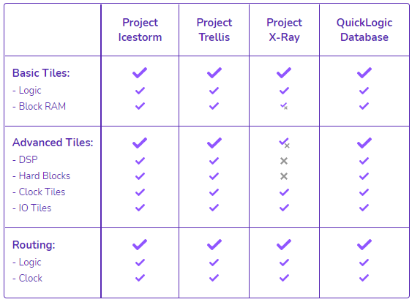
Fuzzer Database
Functionality
Various
Designs
Compare

Slide 3
Grid Input
Size of Grid (x*y)
Script3
Circuits
Design
Architecture
Current
Architecture
VPR
Speed
Routing Extraction
Template of CLB
Script2
RR_Graph
Script1
Device Model
Original
RR_Graph
Project X-Ray
Symbiflow
DB

Slide 4
I/O
CLB
CLB
CLB
I/O
CLB
I/O
CLB
CLB
CLB
I/O
I/O
CLB
CLB
CLB
I/O
CLB
I/O
CLB
CLB
CLB
I/O

Slide 5
N
S
S
N
Symbiflow
VPR

Slide 6
0,0
1,0
2,0
3,0
0,2
1,2
2,2
3,2
0,1
1,1
2,1
3,1
0,1
1,1
2,1
3,1
0,2
1,2
2,2
3,2
0,0
1,0
2,0
3,0
Symbiflow
VTR

Slide 7
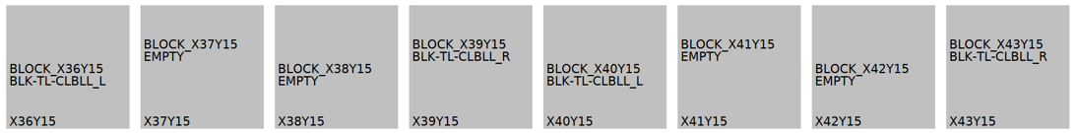
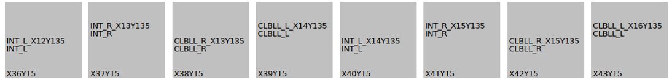
VPR
Symbiflow

Slide 8



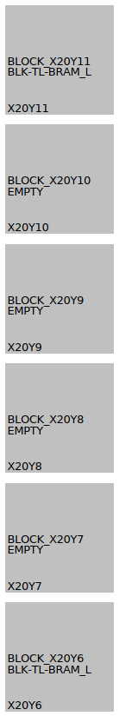



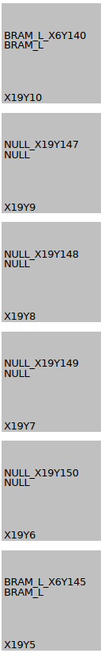
1 Up Shift
2 Up Shift
3 Up Shift
4 Up Shift

Slide 9
Non-cardinal Segments
NN6
Cardinal Segments
Switch
Switch
Switch
Switch
CLB
NW4
CLB
CLB
NN2
CLB
Switch
Switch
Switch
Switch
CLB
CLB
CLB
CLB
WW4
WW2
N1
NW2
Switch
Switch
Switch
Switch
CLB
CLB
CLB
CLB
E1
W1
S1

Slide 10
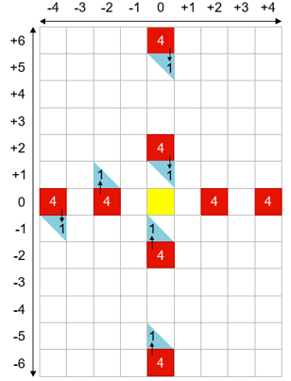
SS6
4 (0, 6)
SS2
4 (0, 2)
WW2
4 (-2, 0)
EE2
4 (2, 0)
Switch
WW4
4 (-4, 0)
EE4
4 (4, 0)
NN2
4 (0, -2)
NN6
4 (0, -6)

Slide 11
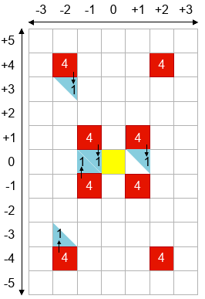
SW6-B
4 (0, 4)
SE6-B
4 (0, 4)
SW6-A
4 (1, 3) – (-3, 3)
SE6-A
4 (0, 3) - (4, 3)
SW6
4 (-4, 4)
Switch
NW6-A
4 (-4, 0)
NW6-B
4 (-4, 1) – (-4, -3)
NW6-B
4 (0, -4)
NW6-A
4 (1, -4) - (-3, -4)
NE6
4 (4, -4)

Slide 12
SW2-A
4 (0, 1) – (-4, 1)
SE2-B
4 (4, 0) – (4, 1)
SW2-B
4 (0, 1)
SW2-B
4 (-4, 0) – (-4, 1)
SW2-A
4 (-4, 0)
SE2-A
4 (4, 0)
Switch
NW2-A
4 (-4, 0)
NE2-A
4 (4, 0)
NW2-B
4 (-4, 0) – (-4, -1)
NW2-B
4 (0, -1)
NE2-B
4 (4, 0) – (4, -1)
NW2-A
4 (0, -1) - (-4, -1)

Slide 13
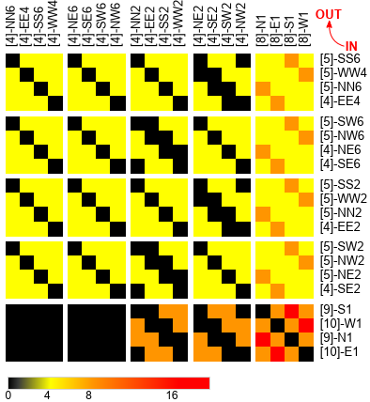
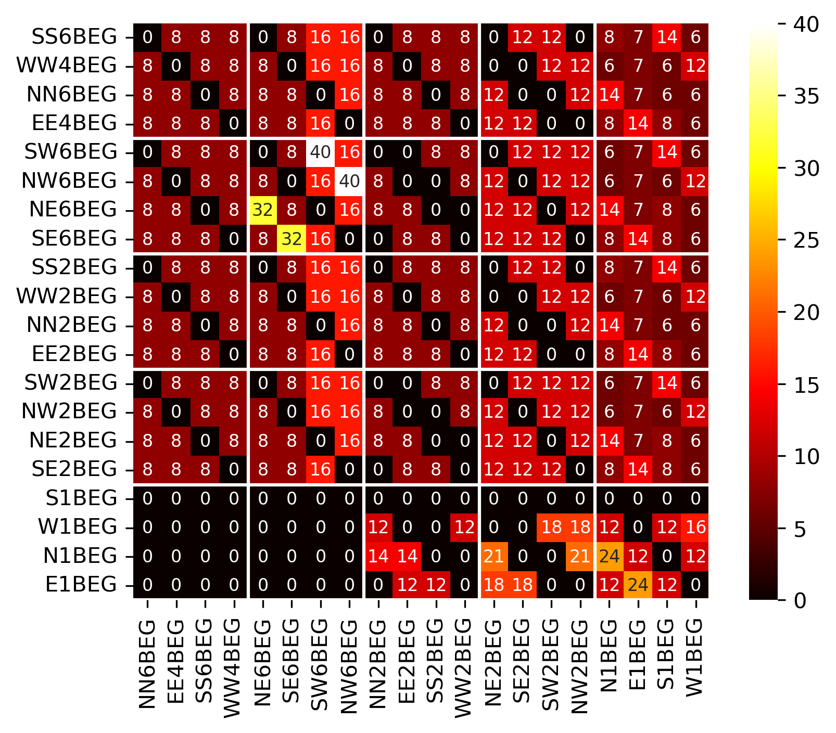
Empty
Tile
Empty
Tile
CHANNEL
CHANNEL
Tile
CHANNEL
Empty
Tile
CHANNEL
Tile
CHANNEL
CHANNEL
XC7A35T
XC7A50T

Slide 14
CHANNEL
Empty
Tile
Empty
Tile
CHANNEL
Tile
CHANNEL
Empty
Tile
CHANNEL
Tile
CHANNEL
CHANNEL

